Slide 1
SU8 DATA MODEL EXAMPLE ART GALLERY
CMPG213 System Analysis & Design I
Mrs LINDA REDELINGHUYS
Linda.redelinghuys@nwu.ac.za

Slide 2
SCENARIO
Die eienaar van ‘n gallery nader jou om vir sy besigheid ‘n rekenaarstelsel te ontwerp. Die stelsel moet hom help om rekord te hou van die volgende besigheidsprosesse:
Kunstenaars sluit by die gallery aan om hul kunswerke daar uit te stal. Hulle word dan bygevoeg op ‘n lys van kunstenaars wat by die gallery mag uitstal. Kunstenaars besluit van tyd tot tyd om hul verbintenis met die gallery te verbreek. Hul name (bestaande uit van en naam) word dan verwyder van die lys van kunstenaars. ‘n Epos-adres moet vir elke kunstenaar gestoor word en elke kunstenaar moet ‘n unieke nommer hê.
Kunstenaars bring hul kunswerke na die gallery om uitgestal te word. Vir elke kunswerk wat hy ontvang, wil die eienaar ‘n beskrywing, die kunstenaar asook die prys wat die kunstenaar daarvoor wil hê, stoor. Elke kunswerk moet ook ‘n unieke nommer hê. Een kunstenaar kan baie kunswerke bring, maar een kunswerk word altyd deur presies een kunstenaar gebring.
Wanneer ‘n kunswerk verkoop word, moet daar rekord gehou word van die verkooptransaksie. Slegs een kunswerk word per transaksie verkoop. Die eienaar betaal die kunstenaar vir die kunswerk en hou die wins. Die unieke nommer van die kunswerk betrokke in die transaksie, die datum waarop die kunswerk verkoop is asook die prys waarvoor dit verkoop is (die eienaar verkoop gewoonlik die kunswerke vir ‘n hoër prys om sy onkostes te dek), moet gestoor word.

Slide 3
SCENARIO
The owner of a gallery approaches you to design a computer system for his business. The system should help keep track of the following business processes:
Artists join the gallery to exhibit their artworks. They are then added to a list of artists who can exhibit at the gallery. Artists decide from time to time to break their connection with the gallery. Their names (consisting of last name and first name) are then removed from the list of artists. An email address must be stored for each artist and each artist must have a unique number.
Artists bring their artworks to the gallery to be exhibited. For each artwork he receives, the owner wants to store a description, the artist as well as the price the artist wants for it. Each artwork must also have a unique number. One artist can bring many artworks, but one artwork is always brought by only one artist.
When an artwork is sold, record must be kept of the sales transaction. Only one artwork is sold per transaction. The owner pays the artist for the artwork and keeps the profit. The unique number of the artwork involved in the transaction, the date the artwork was sold and the price for which it was sold (the owner usually sells the artwork for a higher price to cover his expenses) must be stored.

Slide 4
You break down the scenario into actions as well as into entities & attributes
Artists join the gallery to exhibit their artworks. They are then added to a list of artists who can exhibit at the gallery.
Artists decide from time to time to break their connection with the gallery.
Their names (consisting of last name and first name) are then removed from the list of artists.
An email address must be stored for each artist and each artist must have a unique number.
Artists bring their artworks to the gallery to be exhibited. For each artwork he receives, the owner wants to store a description, the artist as well as the price the artist wants for it.
Each artwork must also have a unique number. One artist can bring many artworks, but one artwork is always brought by only one artist.
When an artwork is sold, record must be kept of the sales transaction.
Only one artwork is sold per transaction.
The owner pays the artist for the artwork and keeps the profit. The unique number of the artwork involved in the transaction, the date the artwork was sold and the price for which it was sold (the owner usually sells the artwork for a higher price to cover his expenses) must be stored.

Slide 5
QUESTION 1
Teken ‘n Gebruiksgeval diagram (“Use Case diagram”) vir bogenoemde scenario.
Draw a Use Case diagram for the above scenario.

Slide 6
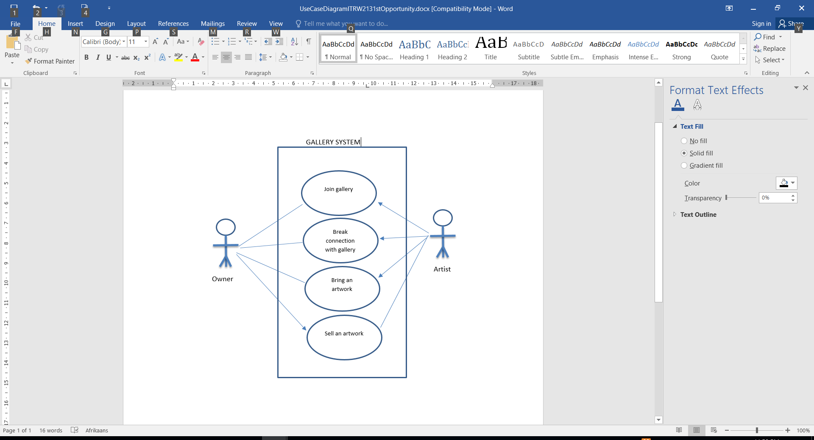
MEMO QUESTION 1

Slide 7
QUESTION 2
A database relation (e.g. a database table) is said to meet third normal form standards if all the attributes (e.g. database columns) are functionally dependent on solely the primary key.
Teken ‘n datamodel met alle entiteite, attribute, primêre sleutels, vreemde sleutels en verwantskappe vir bogenoemde scenario. Onthou dat die datamodel in 3NF moet wees. Teken slegs die finale datamodel.
Draw a data model with all entities, attributes, primary keys, foreign keys and relationships for the above scenario. Remember that the data model must be in 3NF. Only draw the final data model.
To reduce the duplication of data, avoid data anomalies, ensure referential integrity, and simplify data management. E.g
Artist (Artsist_ID (PK)✓½, Artist_FName, Artist_Lname, Artist_Email_Address) ✓½

Slide 8
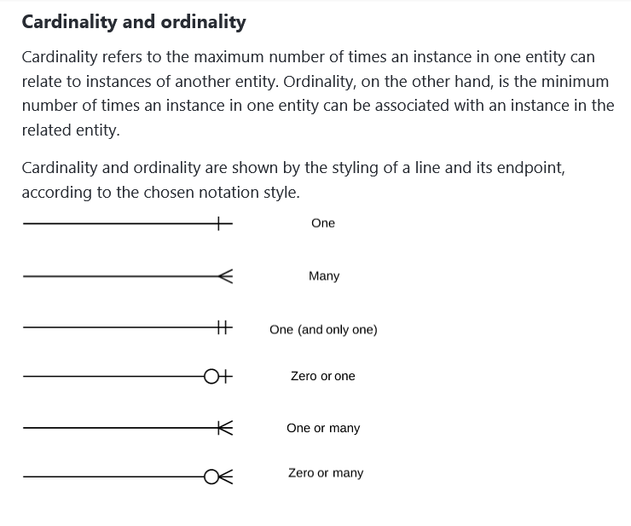

Slide 9
You break down the scenario into actions as well as into entities & attributes
Artists join the gallery to exhibit their artworks. They are then added to a list of artists who can exhibit at the gallery.
Artists decide from time to time to break their connection with the gallery.
Their names (consisting of last name and first name) are then removed from the list of artists.
An email address must be stored for each artist and each artist must have a unique number.
Artists bring their artworks to the gallery to be exhibited. For each artwork he receives, the owner wants to store a description, the artist as well as the price the artist wants for it.
Each artwork must also have a unique number. One artist can bring many artworks, but one artwork is always brought by only one artist.
When an artwork is sold, record must be kept of the sales transaction.
Only one artwork is sold per transaction.
The owner pays the artist for the artwork and keeps the profit. The unique number of the artwork involved in the transaction, the date the artwork was sold and the price for which it was sold (the owner usually sells the artwork for a higher price to cover his expenses) must be stored.

Slide 10
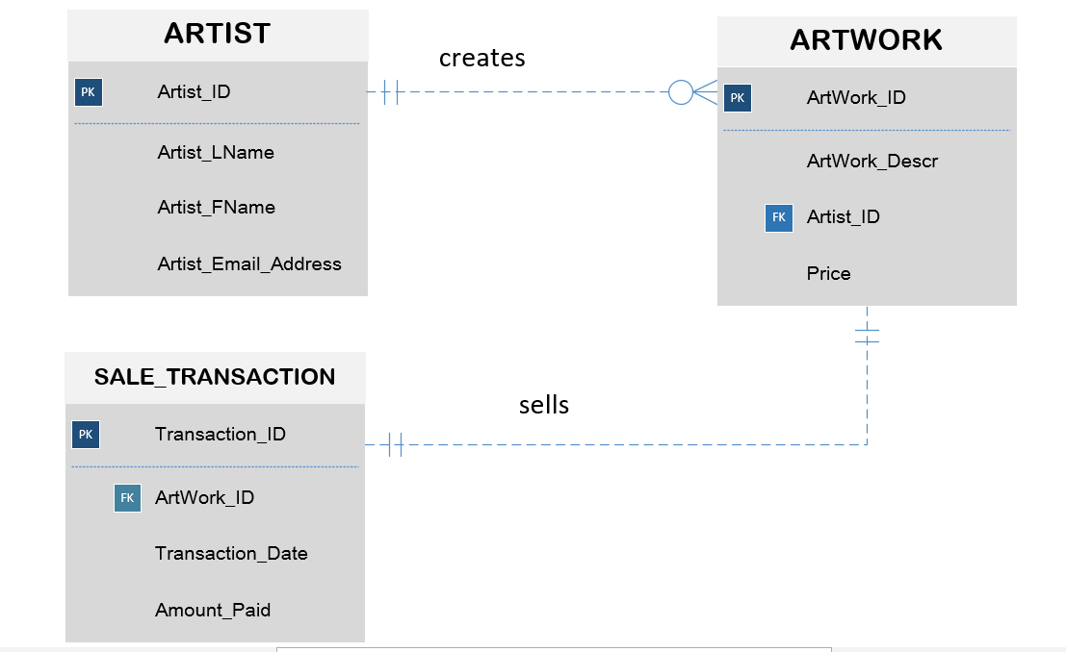
MEMO QUESTION 2
Do not forget the verbs
Min
Max
Min
Max
Min
Max
Min
Max

Slide 11
QUESTION 3
Teken prosesmodelle vir die volgende:
instandhouding van kunstenaars, d.w.s om nuwe kunstenaars by te voeg, bestaande kunstenaars se detail te verander asook om bestaande kunstenaars te verwyder.
instandhouding van kunswerke, d.w.s om nuwe kunswerke by te voeg, bestaande kunswerke se detail te verander asook om bestaande kunswerke te verwyder.
Die verkoop van ‘n kunswerk. Onthou dat finansiële transaksies volgens ouditreëls nie verander of verwyder mag word nie.
Draw process models for the following:
maintenance of artists, i.e. adding new artists, changing existing artists' detail as well as removing existing artists.
maintenance of artworks, i.e. to add new artworks, to change the detail of existing artworks as well as to remove existing artworks.
Selling an artwork. Remember that financial transactions may not be changed or removed according to audit rules.

Slide 12
Key to drawing DFD
Make an appointment
Make an appointment
Of Use-Case diagram/ functionality → becomes Process
Secretary
Of Use-Case diagram, becomes Agent
Secretary
Of Data Model, becomes Data Store

Slide 13
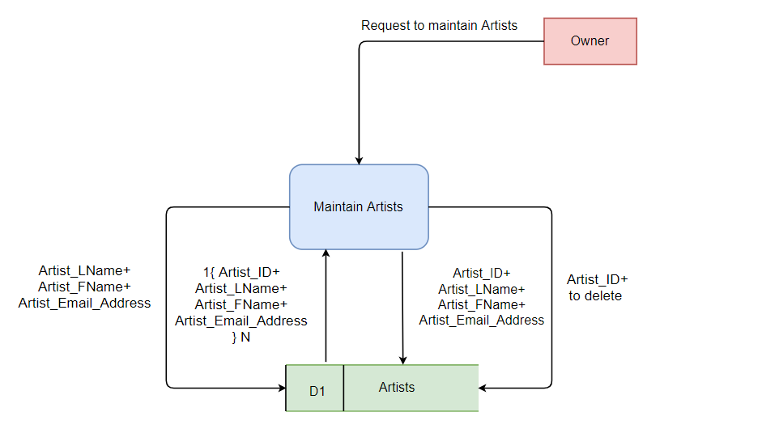
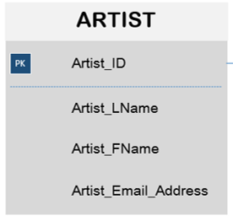
Maintain Artists process model
Data store back to process model as you populate the process with N instances of data . So you can chose the IDs for update and delete data flows. From all the data that is available in your entity
Update data flow from process to data store …contains everything
Delete data flow is easy only pass the ID of the record of the one you want to delete from the process to the data store
Add data flow is without the primary key as DBMS auto assigns from process to data store

Slide 14
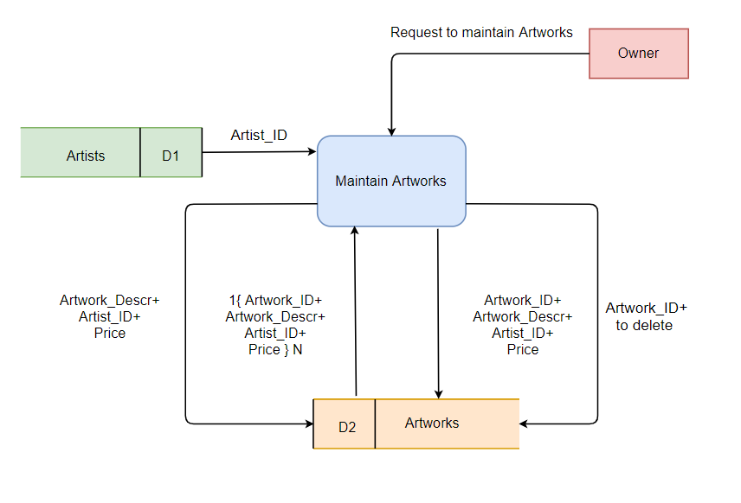
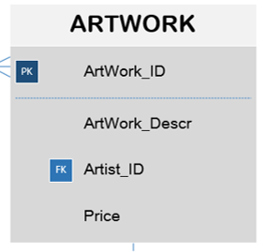
Maintain Artworks process model

Slide 15
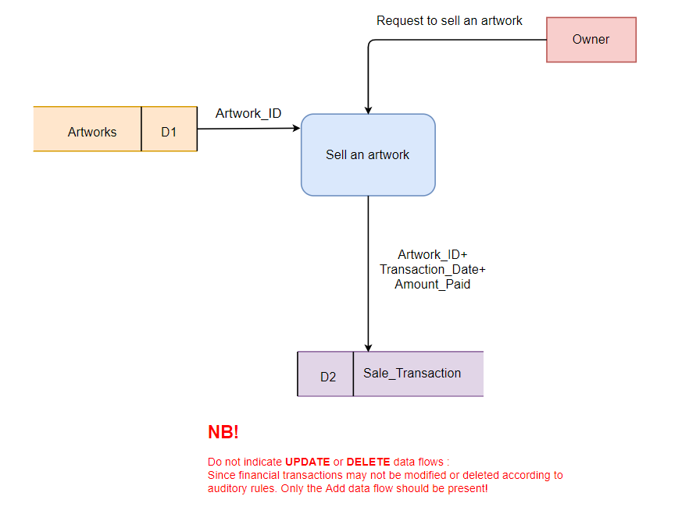
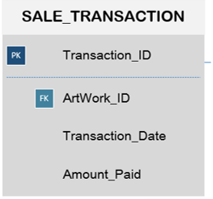
Sell an Artwork process model

